Slide 1

Coronary Heart Disease (CHD)
Notes:
Framingham Heart Study dataset
Total 16 columns, 4240 records
TenYearCHD(no)
3596 records (85%)
TeaYearCHD(yes)
644 records (15%)
Link for
https://www.kaggle.com/amanajmera1/framingham-heart-study-dataset

Slide 2

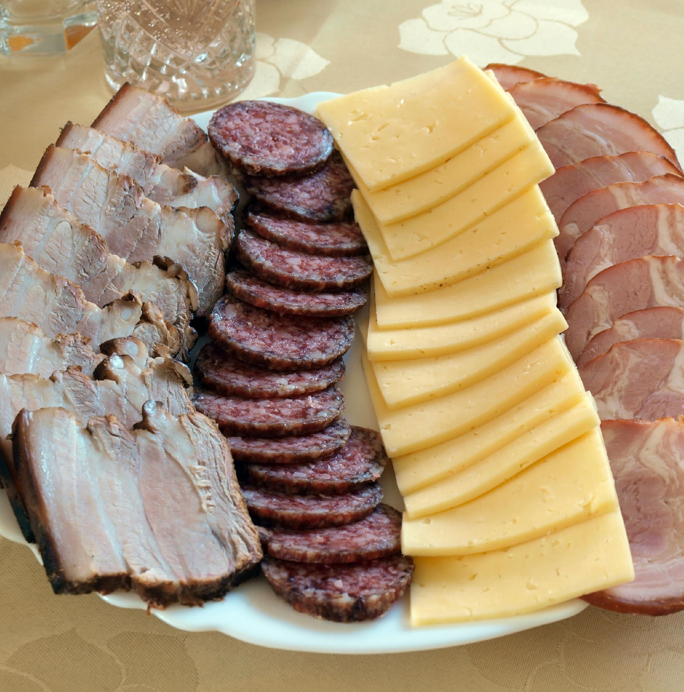


Why do we care about CHD?
Leading cause of death in the United States
Notes:
What is CHD:
Coronary heart disease(CHD) is a type of heart disease that develops when the arteries of the heart cannot deliver enough oxygen-rich blood to the heart. It is the leading cause of death in the United States.
Risk Factors:
Age
Gender
Lifestyle: smoking tobacco, stress
Other medical conditions such as obesity, diabetes, high blood cholesterol and high blood pressure etc.
https://www.nhlbi.nih.gov/health-topics/coronary-heart-disease
https://www.cdc.gov/nchs/data/nvsr/nvsr68/nvsr68_09-508.pdf

Slide 3




Approaches
1.DATA CLEANING
2.MODEL TRAINING
3.MODEL TESTING
4.MODEL TUNING
Notes:
ML Framework Used:
1st We do Data Cleansing (replacing NA and empty values with mode(binomial) and median (asymetric)
2nd we do Model Training (Test various supervised ML classification algorithms)
3rd we do Model Testing (Calculate accuracy)
4th we do Model Tuning(Find Optimal Hyperparameters (aka knobs) that give max accuracy)

Slide 4


Data Cleaning Missing Values Categorical Data
Notes:
For Asymmetrical Distributions
Affected Features: CigsPerDay, TotChol, Glucose, heartRate
Imputation Strategy: NA were replaced with median
For Binomial Distributions
Affected Features: BP Meds, Education
Imputation Strategy: NA were replaced with mode
DATA CLEANING:
Missing values:
7 columns contain missing values with 2 categorical features and 4 numerical features. No columns were missing 10% of the data. We didn’t drop any columns.
2 categorical features: most frequent values.
4 numerical features: median(asymmetrical distribution)
2.Categorical data:
The dataset doesn’t contain any categorical features.
3.Feature Selection
We chose to use the simplest and widely used method: Backward elimination
Before Backward Elimination: 15 features; After: 6 feature left (male, age, cigsPerDay, prevalent Stroke, sysBP, glucose)
Highest accuracy 85.9% (logistic regression)
4.Feature Extraction
In our project, three feature extraction methods were used: PCA, LDA and KPCA. The models yields very similar result with highest 85.7% accuracy.

Slide 5

Model Training Logistic Regression SVM (linear and RBF kernel) Naïve Bayes Random Forest KNN
Decision Tree
Notes:
We used seven machine learning classification models which are:
logistic
linear SVM and RBF kernel SVM
Naive Bayes
Random Forest
KNN
Decision Tree
Our data was splitted into 70% and 30%. First of all, we run all the seven models on the raw dataset with all the 15 features.
Noticing it may not be the optimized result, different optimization approaches were applied.

Slide 6
Feature Engineering Feature Selection Feature Extraction
Notes:
DATA CLEANING:
1.Feature Selection
We chose to use the simplest and widely used method: Backward elimination
Before Backward Elimination: 15 features; After: 6 feature left (male, age, cigsPerDay, prevalent Stroke, sysBP, glucose)
Highest accuracy 85.9% (logistic regression)
2.Feature Extraction
In our project, three feature extraction methods were used: PCA, LDA and KPCA.

Slide 7

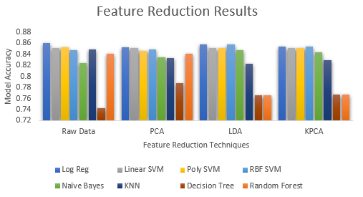
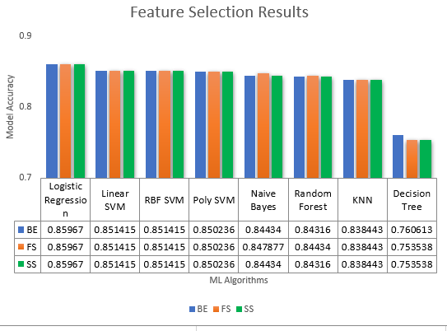
Model Testing - which model wins?
Logistic Regression (after feature selection (Backward elimination) and feature reduction (PCA))
RBF SVM (after feature reduction (LDA and kPCA))
Notes:
Feature Selection Results:
We implemented 8 models with 3 dim reduction methods (PCA, LDA, KPCA) resulting in 24 combinations.
Winning Model was Log Reg which gave an accuracy of 85.96%
Feature Reduction Results:
We implemented 7 models with 3 dim reduction methods (PCA, LDA, KPCA) resulting in 21 combinations.
Winning Model was RBF SVM which gave an accuracy of 85.7%.

Slide 8

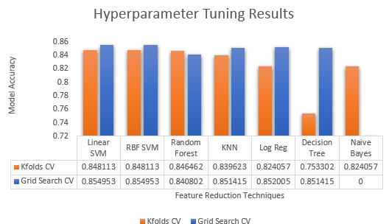
Model Tuning
Linear & RBF SVM (K-Fold CV)
Linear & RBF SVM (after GridSearch CV)
K-fold Cross-validation Grid Search Cross-validation
Notes:
K-Fold:
In this project, we used the K-fold cross validation method to evaluate how well our model is doing.
We splitted our data to 10 folds and each model used 9 folds as training set, and 1 fold as testing set. After 10 iterations,
the performance of the model for each 10 iterations is averaged to produce an overall measurement.
As shown in the graph, Linear SVM and RBF SVM produce highest result with 84.81% accuracy.
Grid Search Cross-Validation:
In this project, we used GridSearchCV approach to choose the best combination of hyperparameter.
We defined sets of values for hyperparameters, and each model used every combination of the values.
As shown in the graph, Linear SVM and RBF SVM produce highest result with 85.49% accuracy.

Slide 9

Learning Outcomes
1.Correlation Matrix’s Output doesn’t get feed as input for Backward Elimination.
2.Backward Elimination doesn’t get feed as input for Dimension Reduction(PCA,LDA,KPCA).
3.Fit_Transform() on the X_train means we are doing standardization on the dataset
4.Precedance Constraint: 1st we do feature selection and then we do hyperparameter tuning
Notes:
Correlation Matrix’s Output doesn’t get feed as input for Backward Elimination.
because both Correlation Matrix and Backward Elimination are Feature Selection Methods
Feature Selection (Backward Elimination) doesn’t get feed as input for Dimension Reduction (PCA, LDA, KPCA)
because in dimension reduction the dimensions are reduced based on a % variance retained from the dataset
Fit_Transform() on the X_train means we are doing standardization on the dataset (rescaling values such that mean = 0 and stdev = 1)
Precedance Constraint: 1st we do feature selection (Backward Elimination) to get good features (6 out of 15 features) and use the
filtered features as input for hyperparameter tuning in order to get a model with max accuracy

Slide 10
Conclusion
Leading risk factors
Gender (male)
Age
Prevalent Stroke
Smoking
High glucose level
Systolic Blood Pressure
Recommendations for preventing CHD
Dietary Choices
Limiting Carbs (lowers glucose levels)
Limiting Sugar (lowers glucose levels)
Limiting Salt (lowers blood pressure)
Lifestyle Choices
Quit smoking (lowers glucose levels)
Exercising (lowers glucose levels, lowers blood pressure)
Notes:
Before we started this project, we assumed BMI would be the main risk factor of CHD.
From feature selection, we learned that (gender, age,prevalent stroke, smoking, high glucose levels and blood pressure) contribute to CHD.
(gender, age and prevalent stroke) are uncontrollable factors for which we cannot suggest recommendations to prevent CHD.
(smoking, high glucose levels, blood pressure) are controllable factors for which we suggest recommendations to prevent CHD.
(Limiting carbs means that we have less glucose in our bloodstream thus results in reduced glucose levels
Sugar is broken down into (50% frutose and 50% glucose) in the body. Reducing sugar means that we have less glucose in our bloodstream thus results in reduced glucose levels
Limiting Salt means that we have less sodium in our blood stream
Exercising decreases insulin resistance (hormone that signals the cells to process sugar efficiently which results in reduced glucose levels)
Exercising makes your heart stronger. A stronger heart pumps blood with less effort which means that less force is exerted on the arteries (lower blood pressure).
Although the result of feature selection did not match our hypothesis, the main reason of having CHD is still inseparable from your daily health care.
This leads to our conclusion of preventing getting CHD: have a healthy diet, no smoking, and keeping your body active.

Slide 11

References
Felman, A., 2019. What to know about coronary heart disease. MedicalNewsToday.
Shekhar, A., 2018. What is Feature Engineering for Machine Learning?. MindOrks.
Chang, C, 2019. A Library for Support Vector Machines.
Rish, Irina, 2001. An empirical study of the naive bayes classifier. IJCAI 2001 workshop on empirical methods in artificial intelligence, (Aug,2001),41-46. http://citeseerx.ist.psu.edu/viewdoc/summary?doi=10.1.1.330.2788
Prediction of Coronary Heart Disease using Supervised Machine Learning Algorithms. (March 2001). Retrieved March,26,2020 From https://www.ukessays.com/essays/computer-science/prediction-of-coronary-heart-disease-using-supervised-machine-learning-algorithms.php

